Slide 1
Project Presentation
Team 8
Tyler Simon
Harsha Pitawela
Zikun Chen

Slide 2
Technologies
PHP – Serverside
Javascript – Clientside validations & controls
MySQL - DB
PHPUnit – Unit Testing tool
Not strict MVC but modularized

Slide 3
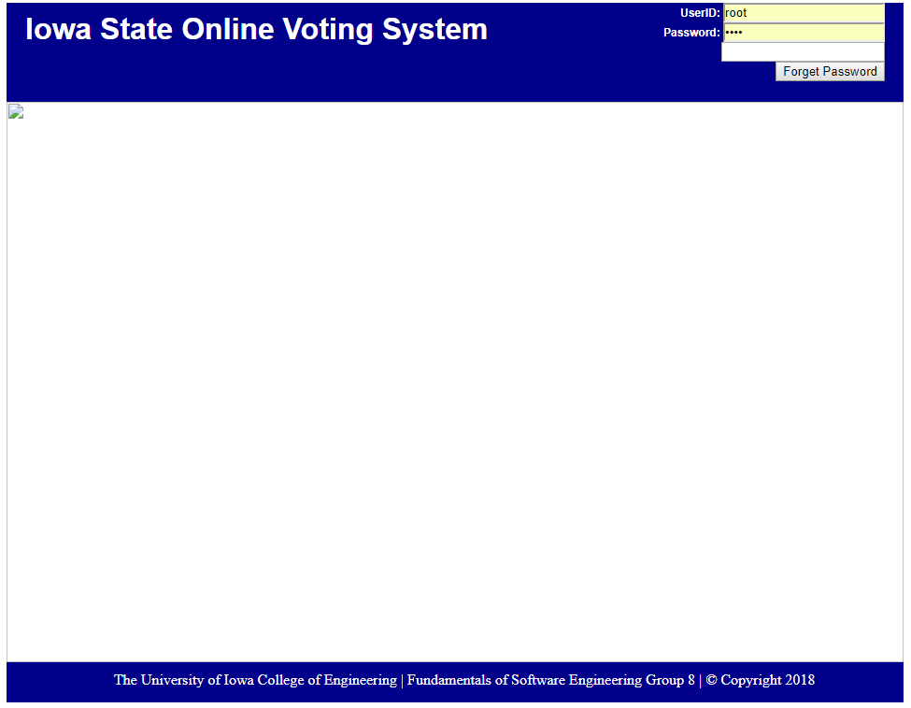
Challenges
Lack of knowledge in web development
Lack of experience in requirement gathering
Lack of experience in Testing
Challenges in work coordination with version control
Lack of knowledge in Election System
Lack of knowledge in Database systems

Slide 4
How we overcame
Through knowledge sharing
Through group meeting discussion
Through google
Through Lynda.com
Through github

Slide 5
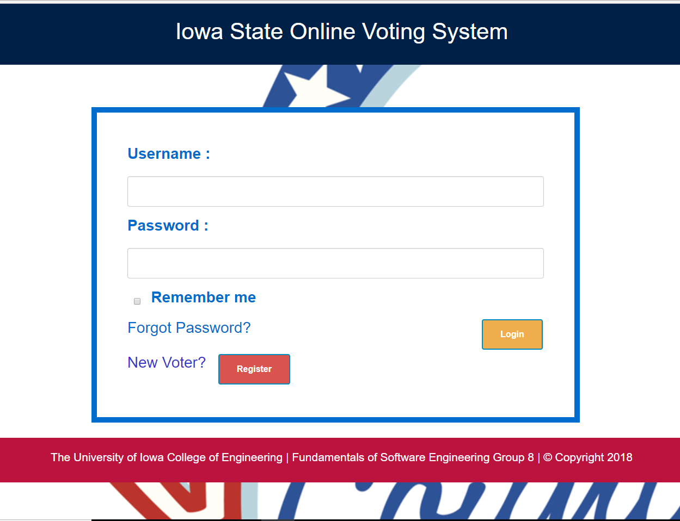
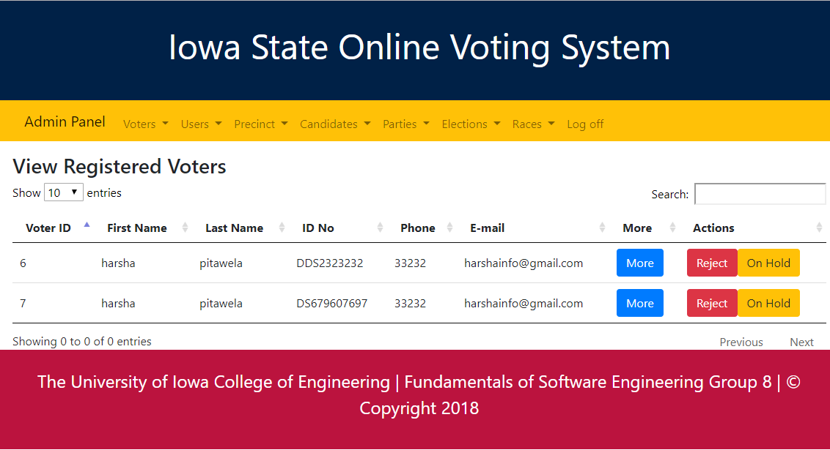
Progress we made
Improved knowledge in PHP, Javascript, MySQL and PHPUnit
Improved skills in requirement gathering
Improved skills in System Design

Slide 6
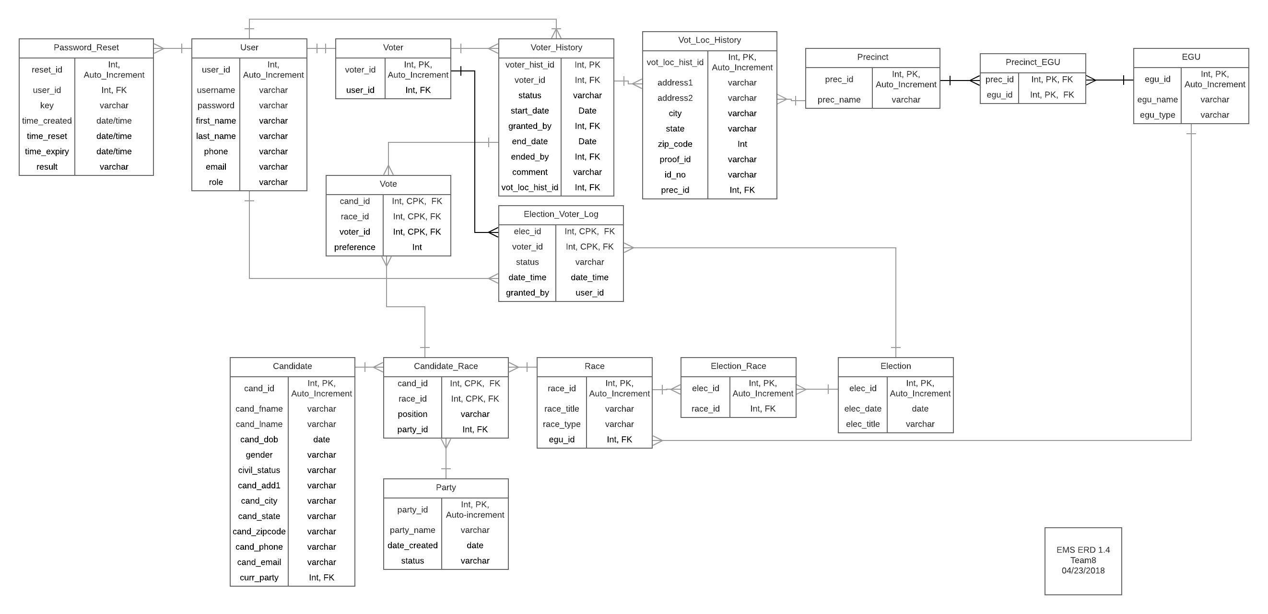
Database Design

Slide 7
Future Improvements
Automating Precinct Addition
Automating Candidate Addition
Support Races with Yes/No voting

Slide 8
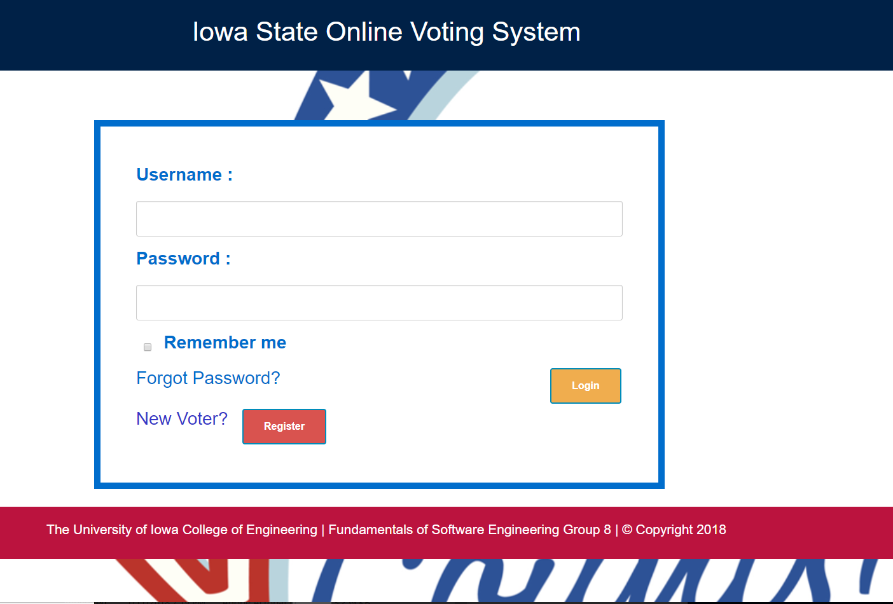
Login Page

Slide 9
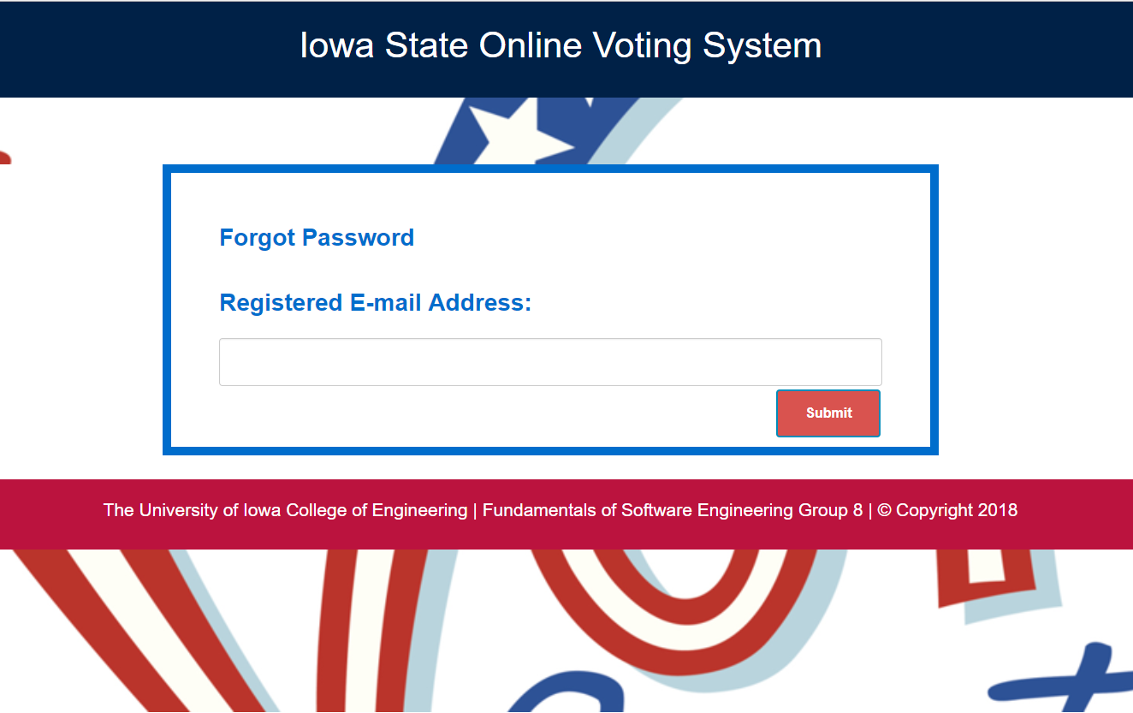
Forgot Password Page

Slide 10
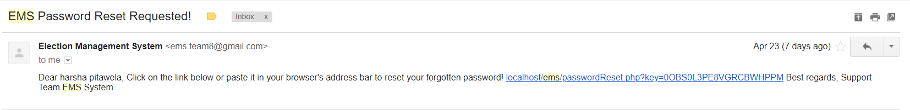
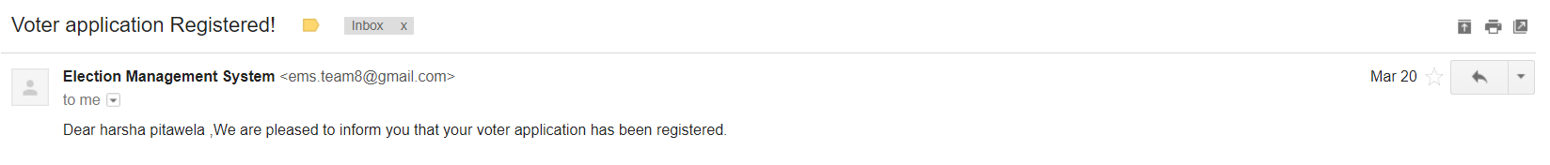
E-mail Notifications

Slide 11
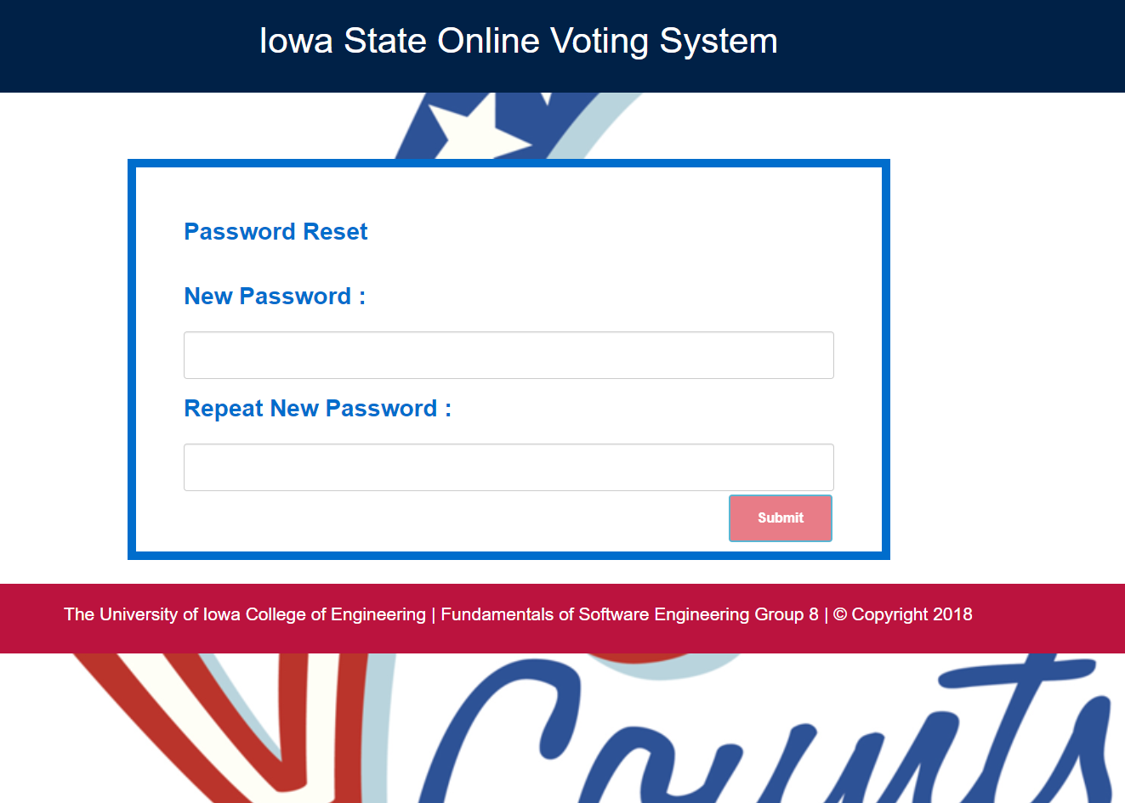
Reset Password Page

Slide 12
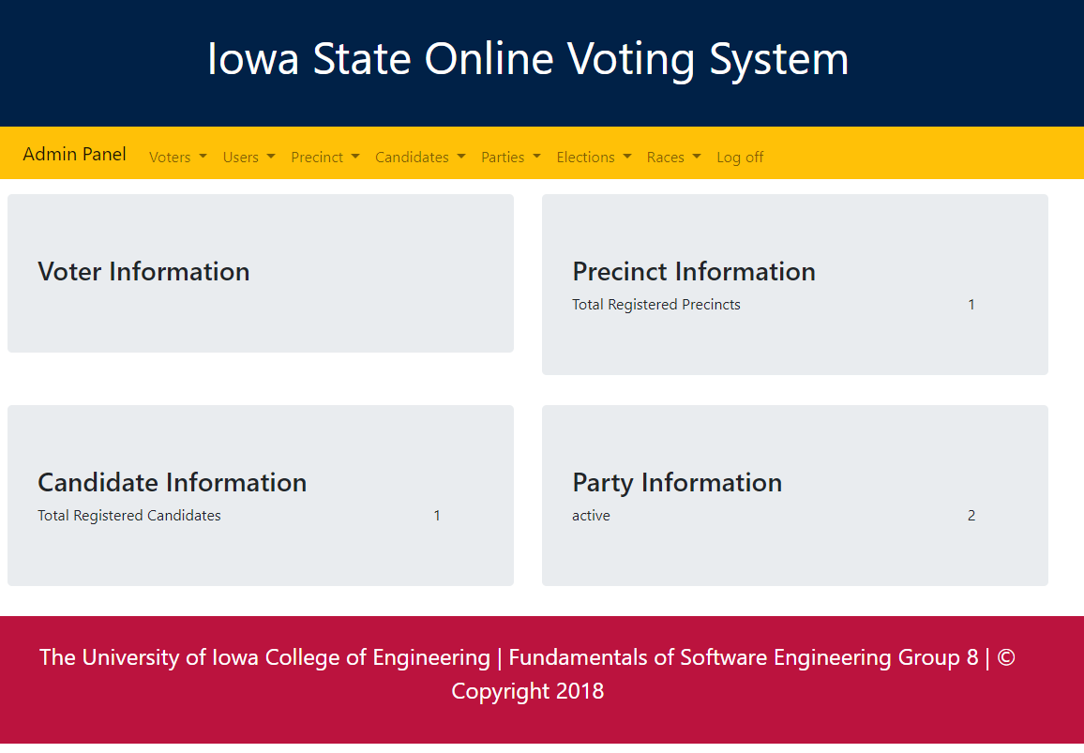
Admin Page

Slide 13
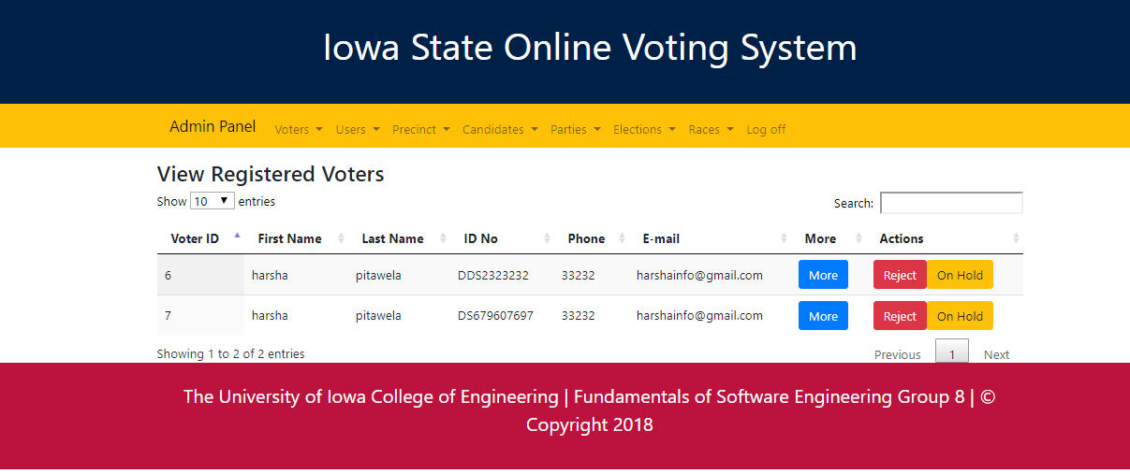
Register/Reject/Onhold Voters

Slide 14
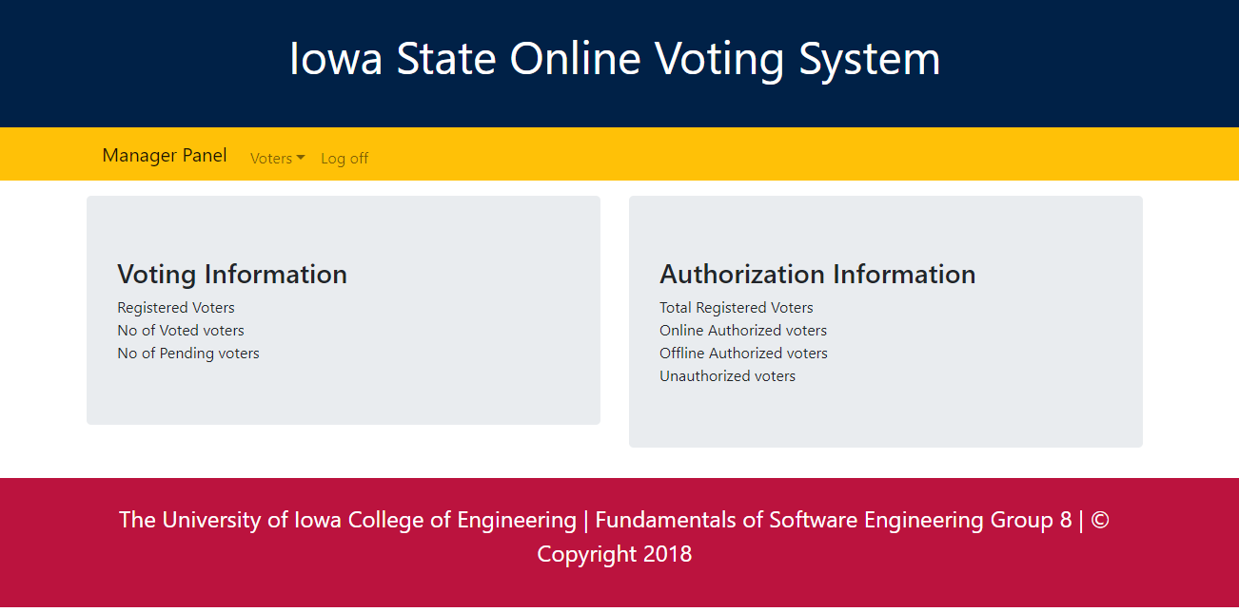
Manager Page

Slide 15
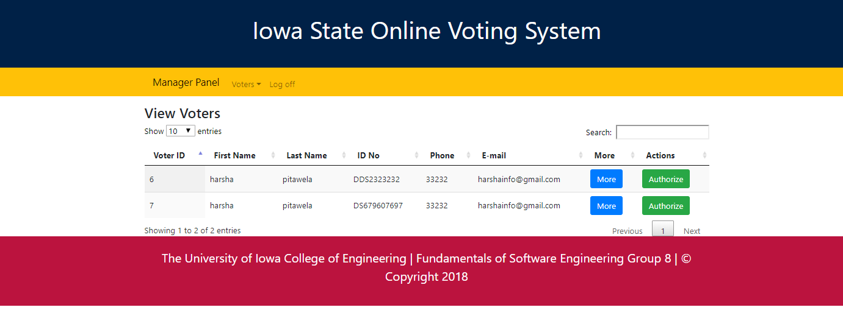
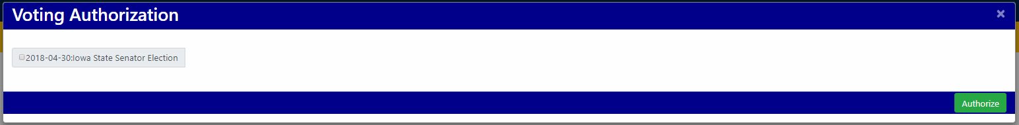
Authorizing Voter by Manager

Slide 16
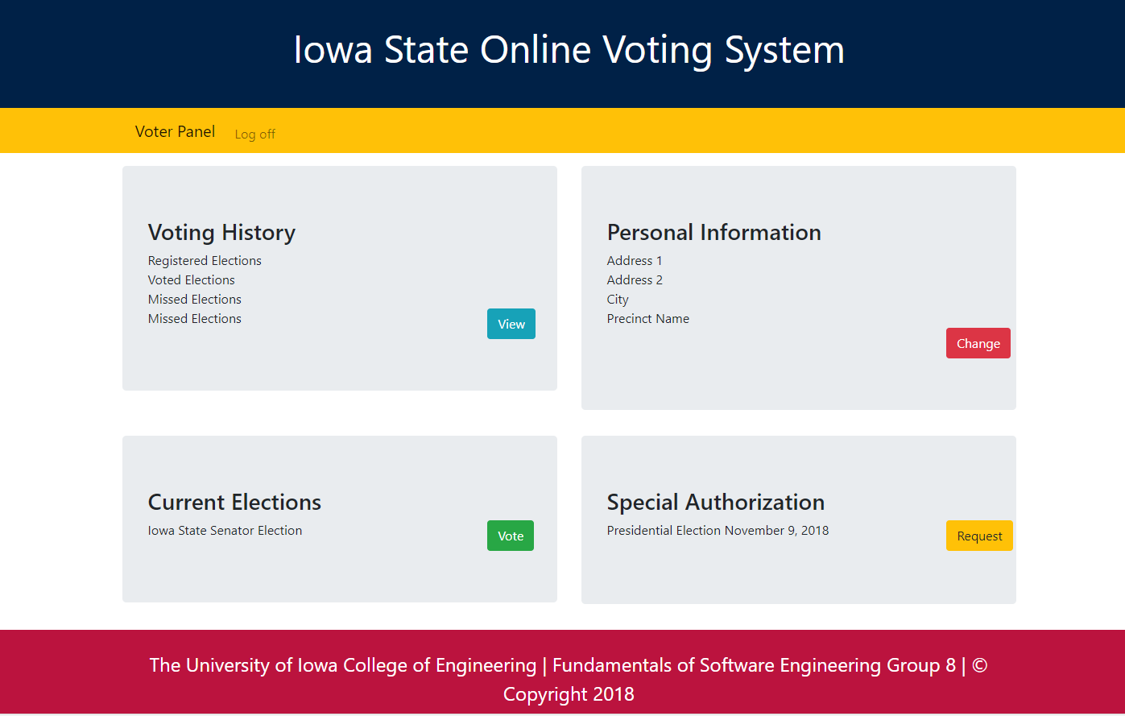
Voter Page

Slide 17
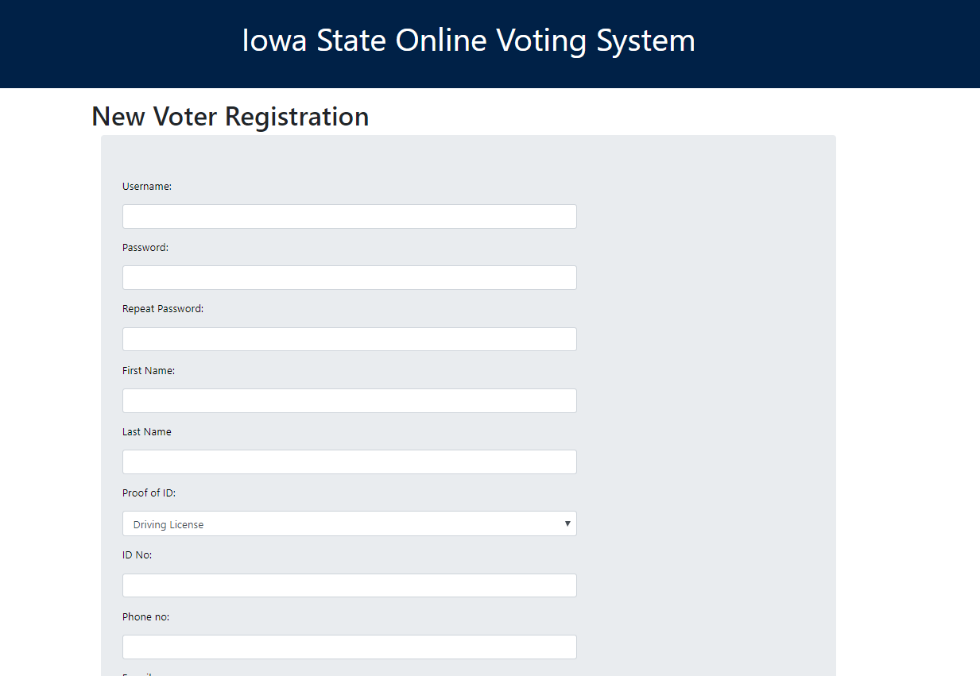
Voter Registration Page

Slide 18
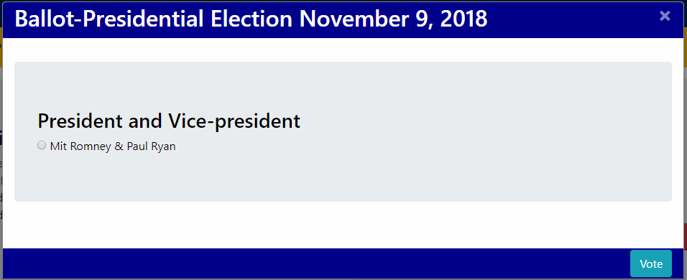
Voting Page

Slide 19
Thank you

